Slide 1



ADD/OFFER/CAMPAIGN Effect On Revenue Increment
View in Power BI
Last data refresh:
11/25/2024 8:34:37 AM UTC
Downloaded at:
11/28/2024 7:01:07 AM UTC

Slide 2
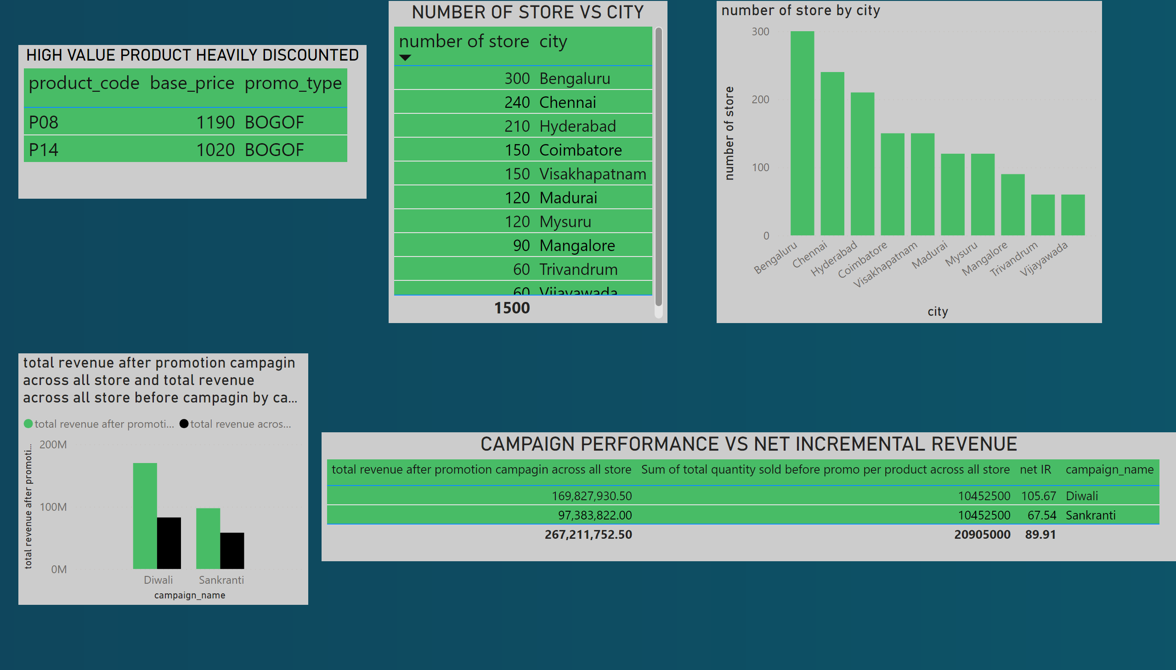
Page 1
Notes:
HIGH VALUE PRODUCT HEAVILY DISCOUNTED
No alt text provided
NUMBER OF STORE VS CITY
No alt text provided
clusteredColumnChart
No alt text provided
CAMPAIGN PERFORMANCE VS NET INCREMENTAL REVENUE
No alt text provided
clusteredColumnChart
No alt text provided

Slide 3
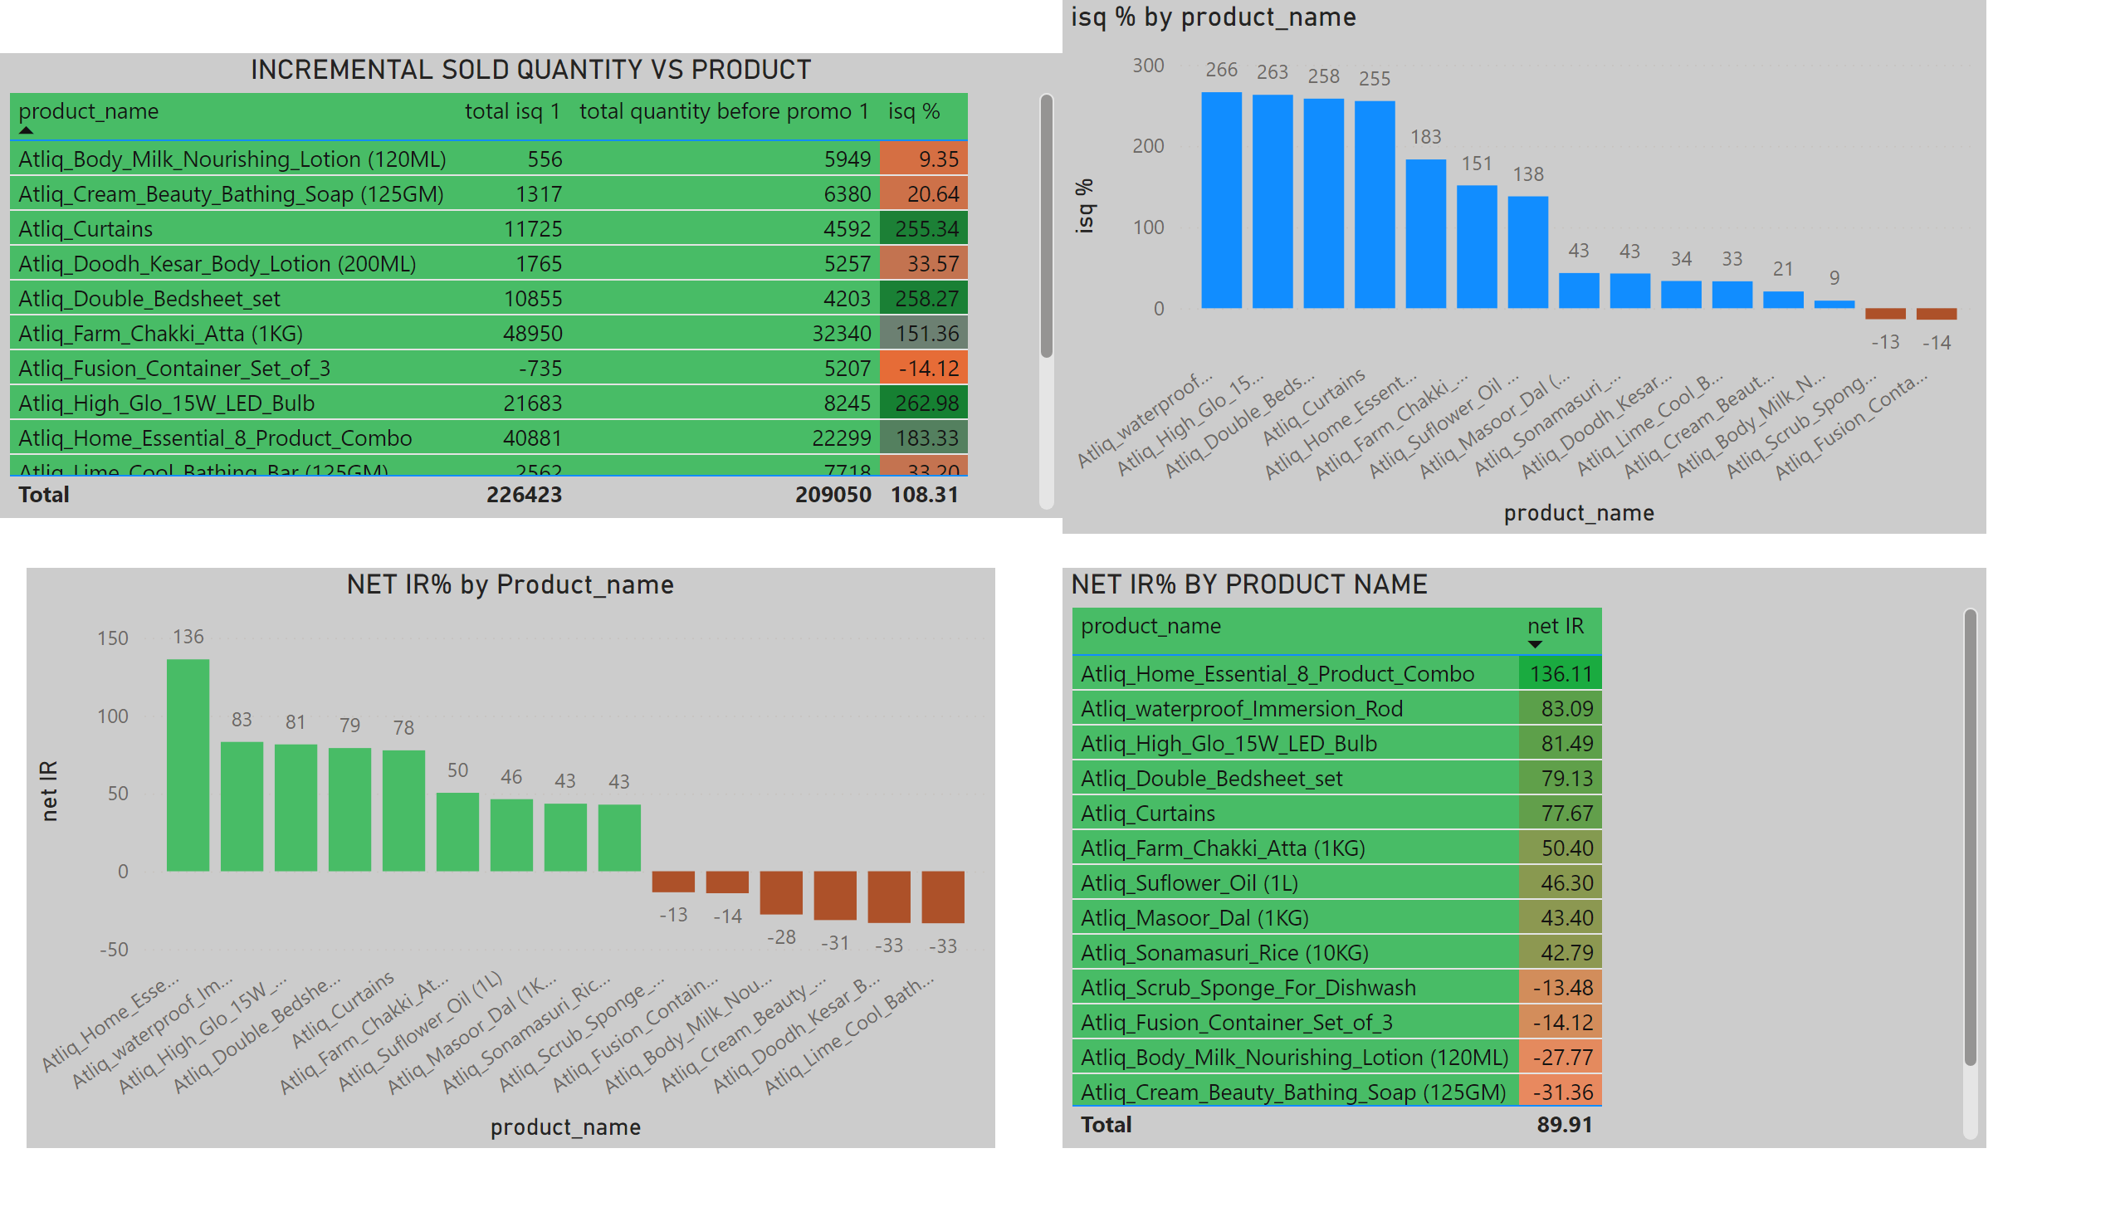
INCREMENTAL SOLD QUANTITY ANALYSIS
Notes:
INCREMENTAL SOLD QUANTITY VS PRODUCT
clusteredColumnChart
No alt text provided
NET IR% by Product_name
No alt text provided
NET IR% BY PRODUCT NAME
No alt text provided

Slide 4
RECOMMENDATION
1. For product having negative incremental revenue percentage(IR%) there is no benefit of running the campaign on these products.

Slide 5
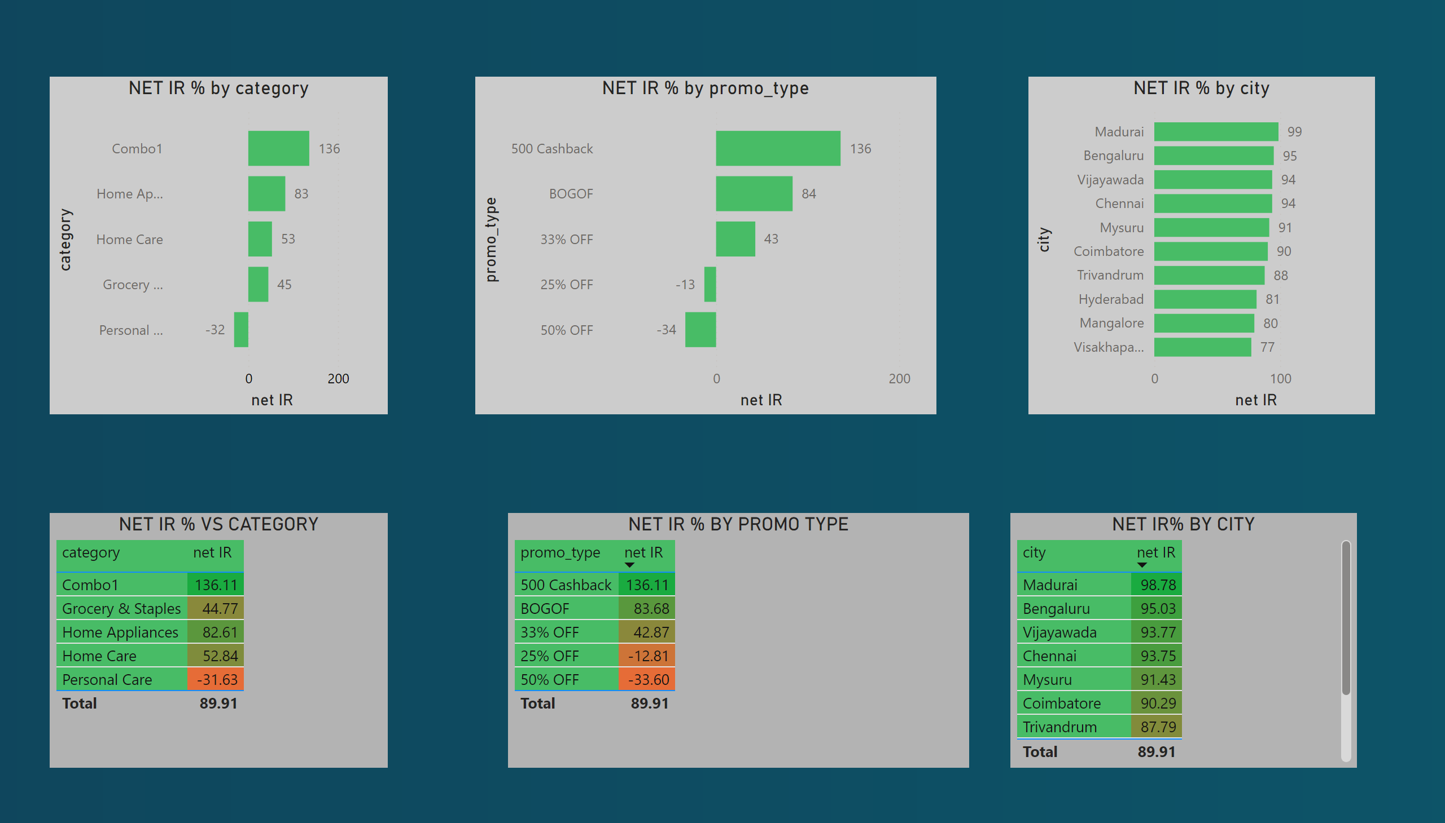
INCREMENTAL REVENUE ANALYSIS
Notes:
NET IR % by city
No alt text provided
NET IR % by category
No alt text provided
NET IR % by promo_type
No alt text provided
NET IR % VS CATEGORY
No alt text provided
NET IR % BY PROMO TYPE
No alt text provided
NET IR% BY CITY
No alt text provided

Slide 6
RECOMMENDATION
1. Net incremental revenue percentage(net IR%) generate by personal care categories is negative .evenly if you look all store ,you will find personal care categories generating NEGATIVE IR % . So there is no sense to giving offer /Discount on these categories .
2. 25% OFF and 50% OFF promo type generating negative IR % . So avoid this promo type
3. to check the campaign effect city wise ,then check graph net IR% vs city .

Slide 7
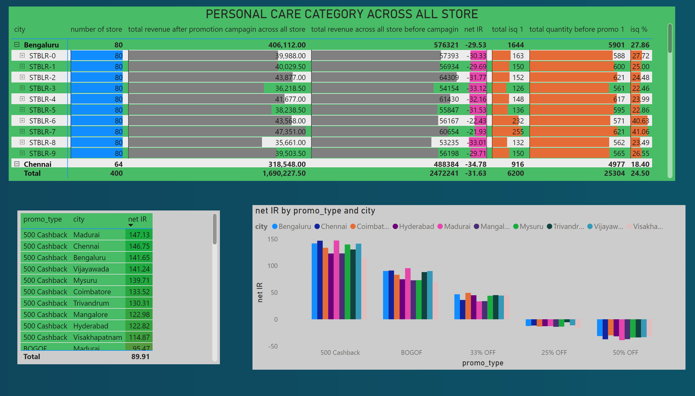
PERSONAL CARE CATEGORY ANALYSIS
Notes:
PERSONAL CARE CATEGORY ACROSS ALL STORE
No alt text provided
tableEx
No alt text provided
clusteredColumnChart
No alt text provided

Slide 8
PERSONAL CARE CONTRIBUTION
1. personal care categories generating negative IR% across all store in which it is available to sell . If all store generating negative IR % with these categories . Then there must be problem with this categories or either we have to come with new type of strategy to increase its sell .

